Slide 1
James Livingston 5
Mainline Sanitary Sewer Lining
June 5, 2025 | 6:00 – 8:00 p.m.
Notes:
MARIE begins

Slide 2
Welcome
Moderator
Presenters
MARIE KEISTER
MurphyEpson
TIFFANY CONN
Blueprint Columbus
CAMERON KEIR
Blueprint Columbus
NICK DOMENICK
Blueprint Columbus
Notes:
MARIE introduces herself and then the team. TIFFANY says a brief welcome, each team member says hello.

Slide 3
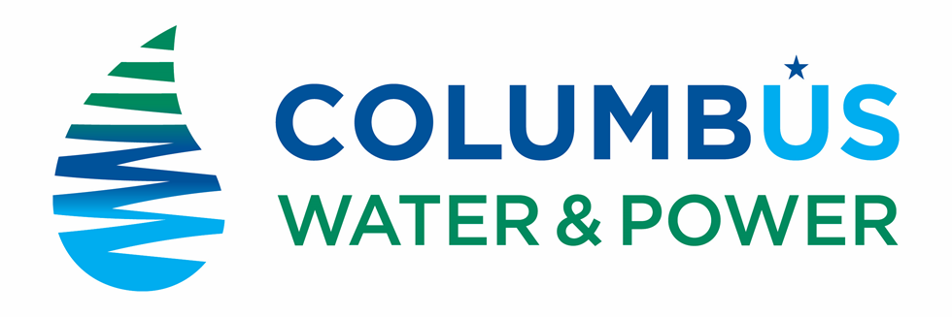

First things first! We changed our name
New name, new logo, same commitment to clean water
Notes:
MARIE- Talk about new brand—emphasize that the reason behind the name change was due tofeedback from surveys and focus groups with employees, residents and other stakeholders through which it became apparent that our previous name did not convey what we do as a department

Slide 4
Agenda
Blueprint 101: A Refresher
Mainline Lining: A Deeper Dive
Mainline Lining Process
What’s Next? Outreach!
Notes:
MARIE

Slide 5
Tiffany Conn & Cameron Keir
Blueprint Columbus Outreach
Columbus Water & Power
Blueprint 101
Notes:
TIFFANY/Cameron

Slide 6
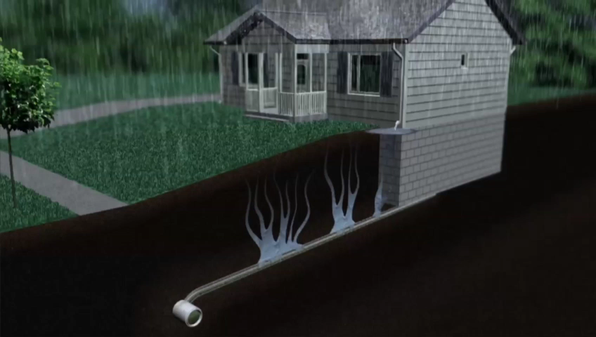
Notes:
CAMERON
WHAT IS THE KEY ISSUE WE ARE TRYING TO SOLVE, WHY IS IT HAPPENING?
MENTION NEIGHBORHOODS, MENTION SEWAGE

Slide 7
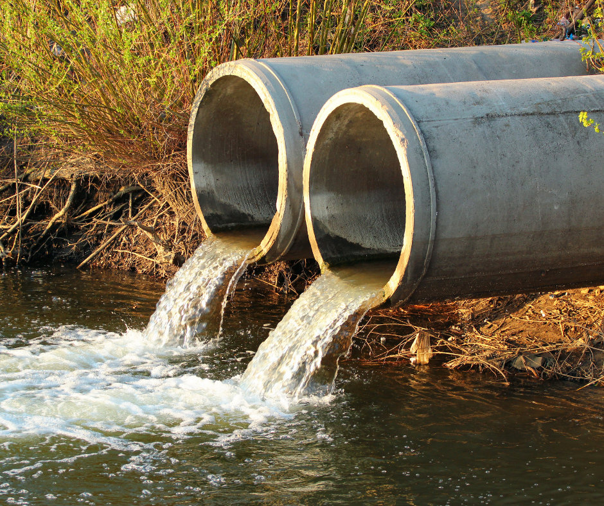
Rainwater in our Sanitary Sewer System Causes:
Sewer overflows into our rivers
and streams
Basement backups (sewage coming
up from floor drain)
        AND
Pollutants found on the street (dirt, oil, trash, etc.) get carried to our rivers and streams by storm sewers
Notes:
CAMERON
OHIO EPA
CONSENT ORDER
DIFFERENT SOLUTION THAT USES SUSTAINABILITY

Slide 8
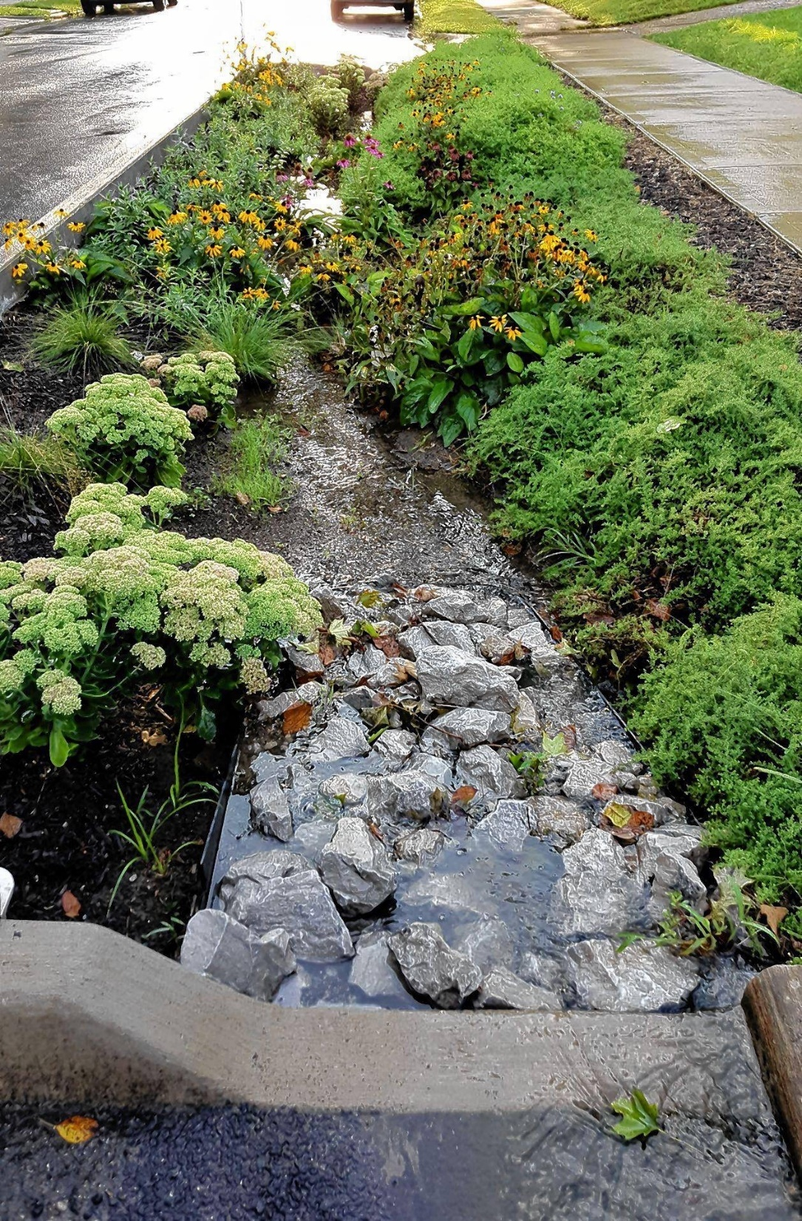
Blueprint: An Innovative, Green Solution
Invests in fixing our existing infrastructure
Uses local materials, native plants
Creates opportunities to improve stormwater discharges
Adds permanent local jobs
Engages neighborhoods, residents
Addresses consent order requirements
Notes:
CAMERON
Create opportunities to improve stormwater discharges
Route water away from houses to streets
Treat with green infrastructure before discharging
Improve rivers, neighborhoods, local economy
Treats and reduces rainwater discharges
Routes water away from houses to streets
Uses plants and nature to drain and treat
Improves water quality in rivers and streams
Engages neighborhoods and residents
Provides local jobs

Slide 9
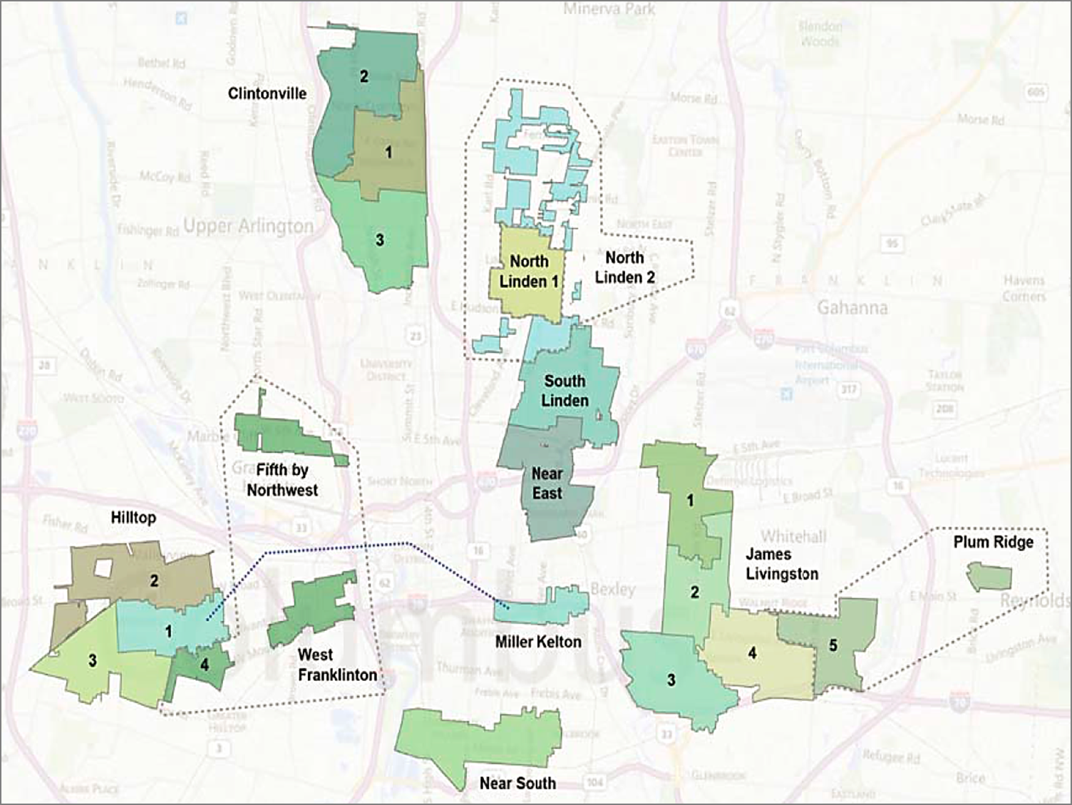
Blueprint Columbus
18,404 acres & 21 project areas throughout Columbus
Notes:
CAMERON
WE ARE ALL OVER THE CITY
21 neighborhoods, 30-year project, determined by separate sanitary and storm sewers, locations of SSOs, frequency of SSOs and basement backups, as well as proximity of SSOs to schools, water sources, etc.

Slide 10
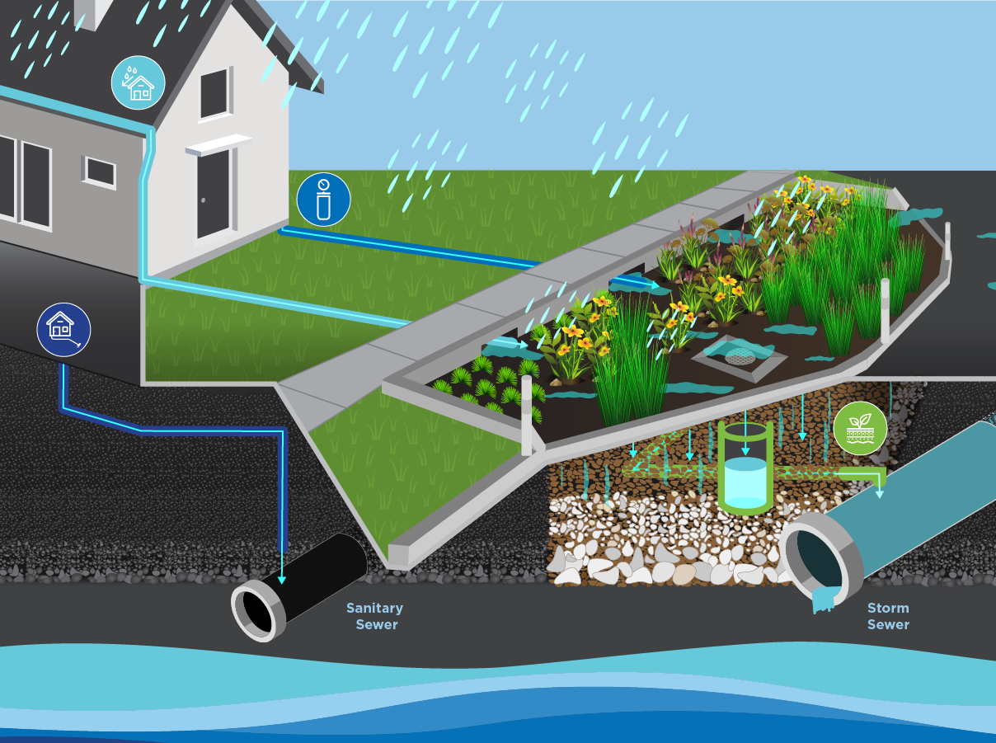
How Green Infrastructure Works
Notes:
CAMERON
HERE IS A LOOK UNDERGROUND, WHAT OUR PROCESS DOES
WE MOVE WATER AWAY FROM THE HOME
WE FILTER AND SLOW WATER OFF THE STREETS TO REDUCE FLOODING AND OVERFLOWS USING GREEN INFRASTRUCTURE
SHOW VARIOUS INLET AREAS AND OUTLETS,
MENTION SEPARATE SYSTEMS IN COLUMBUS

Slide 11




Four Pillars Timeline
2031
2031
Summer 2025
2026/2027
Lateral Lining
Roof Water Redirection
Sump Pumps
Green Infrastructure
Keeps rainwater out of sanitary sewer
Seals cracks and small breaks in pipe that carry rain away from your home to sewers
Redirects rainwater away from your home and to the street, so that it can’t enter the sewer through connection joints around your home
Collects rainwater around your home’s foundation
Discharges rainwater into a pipe that discharges to the street
Filters rainwater from
the street
Removes pollutants
and trash
Makes rainwater cleaner when it reaches rivers and streams
Notes:
CAMERON
THESE ARE THE 4 PILLARS
THIS IS HOW WE WORK THROUGH

Slide 12










Schedule & Outreach-Design Phases
Current Phase
SURVEYING
Preliminary Design
Detailed Design
Final Design
PRECONSTRUCTION
Collect data on underground utilities, trees, parking availability and water flow patterns.
Identify potential green infrastructure locations based on survey data and share with the community for feedback.
Select preferred locations for green infrastructure and mark them in the field. Encourage the public to visit sites and provide feedback.
Finalize plans, sign, and submit construction plans and solicit bids.
Develop plans and processes for green infrastructure construction.
Convey what to expect during construction, introduce the contractor and inspection teams and answer questions about construction timelines.
BLUEPRINT OUTREACH TEAM KEEPING YOU INFORMED
Letter
Door Hanger
Surveyor Onsite
Impact Card
Public Meeting
Letter and Impact Card
Green Infrastructure Locations Marked and Posted Online
Public Meeting
Door Hanger/Impact Card
Green Infrastructure Locations Marked and Posted Online
Final Plans Presented
Plant Selections
Impact Card
Green Infrastructure Locations Marked and Posted Online
Public Meeting
How can residents participate?
Notes:
CAMERON
We are currently at 30% design. What that means is…..

Slide 13
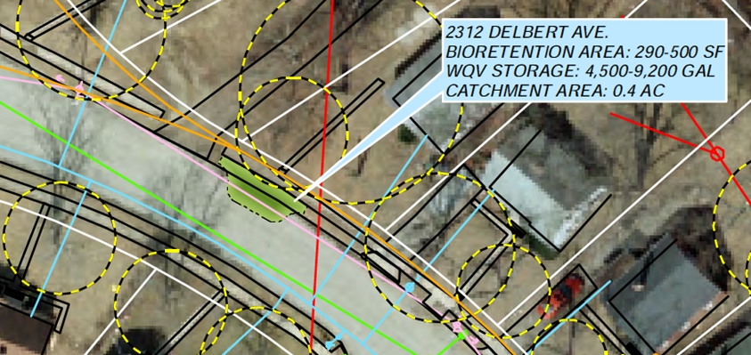
How We Select Improvement Locations
Where are biggest problem areas?
How much water do we need to control?
Where does the water naturally flow?
What barriers exist?
What would improve the neighborhood?
Land Bank/
Green Space
Right-of-Way
Bump-Outs
Pavers
Notes:
TIFFANY
(Will explain what a Land Bank is)

Slide 14


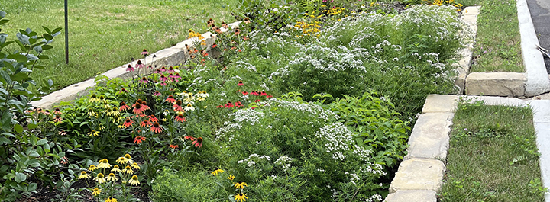


Help Shape the Plan for Your Community
Identify flood prone areas
Report your findings
Know a spot for rain
garden? Let us know
Spread the word
With your feedback, we will shape a specific design for the James-Livingston 5 project area
Notes:
CAMERON
SO HERE IS OUR ASK FOR YOU WHEN YOU LEAVE TONIGHT:
Identify Flood Prone Areas: Take a moment to reflect on locations within your neighborhood where flooding frequently occurs or poses a threat during or after heavy rains.
Report Your Findings: Share your observations with us (How deep is the water, How long does the flooding last, etc.) You can do this by contacting Blueprint Columbus via phone or email.
Know a spot for Rain Garden? Let Us Know: If you see unused green space in your neighborhood, you can let us know where and we will evaluate it for a potential rain garden.
Spread the Word: Encourage your neighbors to participate as well. The more input we receive, the better equipped we’ll be to address these challenges comprehensively.

Slide 15
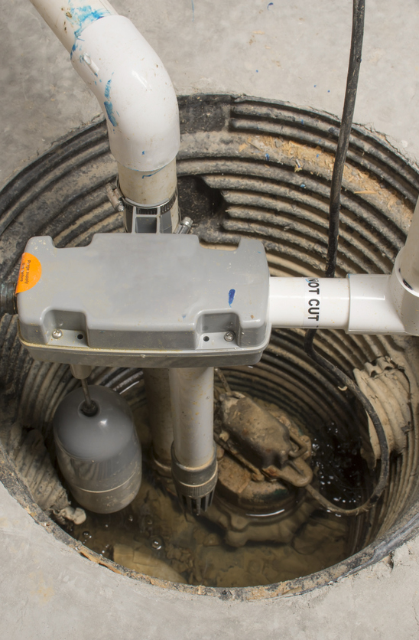
Sump Pump Program
To prevent basement flooding, Blueprint Columbus offers free sump pump installation for qualifying homeowners
To learn more and sign-up visit: blueprintneighborhoods.com or
call (614) 645-1253
Whitehall residents cannot participate in
this program
Notes:
CAMERON
HOW ABOUT SOMETHING FOR FREE?

Slide 16
Pause for Questions
Notes:
CAMERON ANSWERS ANY QUESTIONS WITH TIFFANY '
HAND OFF TO NICK

Slide 17
Mainline Lining: A Deeper Dive
How do we do it? What should I expect?
NICK DOMENICK, P.E.
Project Manager
Columbus Water & Power
REGGIE HOOD
Director
CMCI Prime, AE
TERRY BELL
Regional VP
Inliner Solutions
Notes:
CAMERON – HAND OFF TO NICK
Here's a deeper dive into mainline lining and how it will affect you.

Slide 18
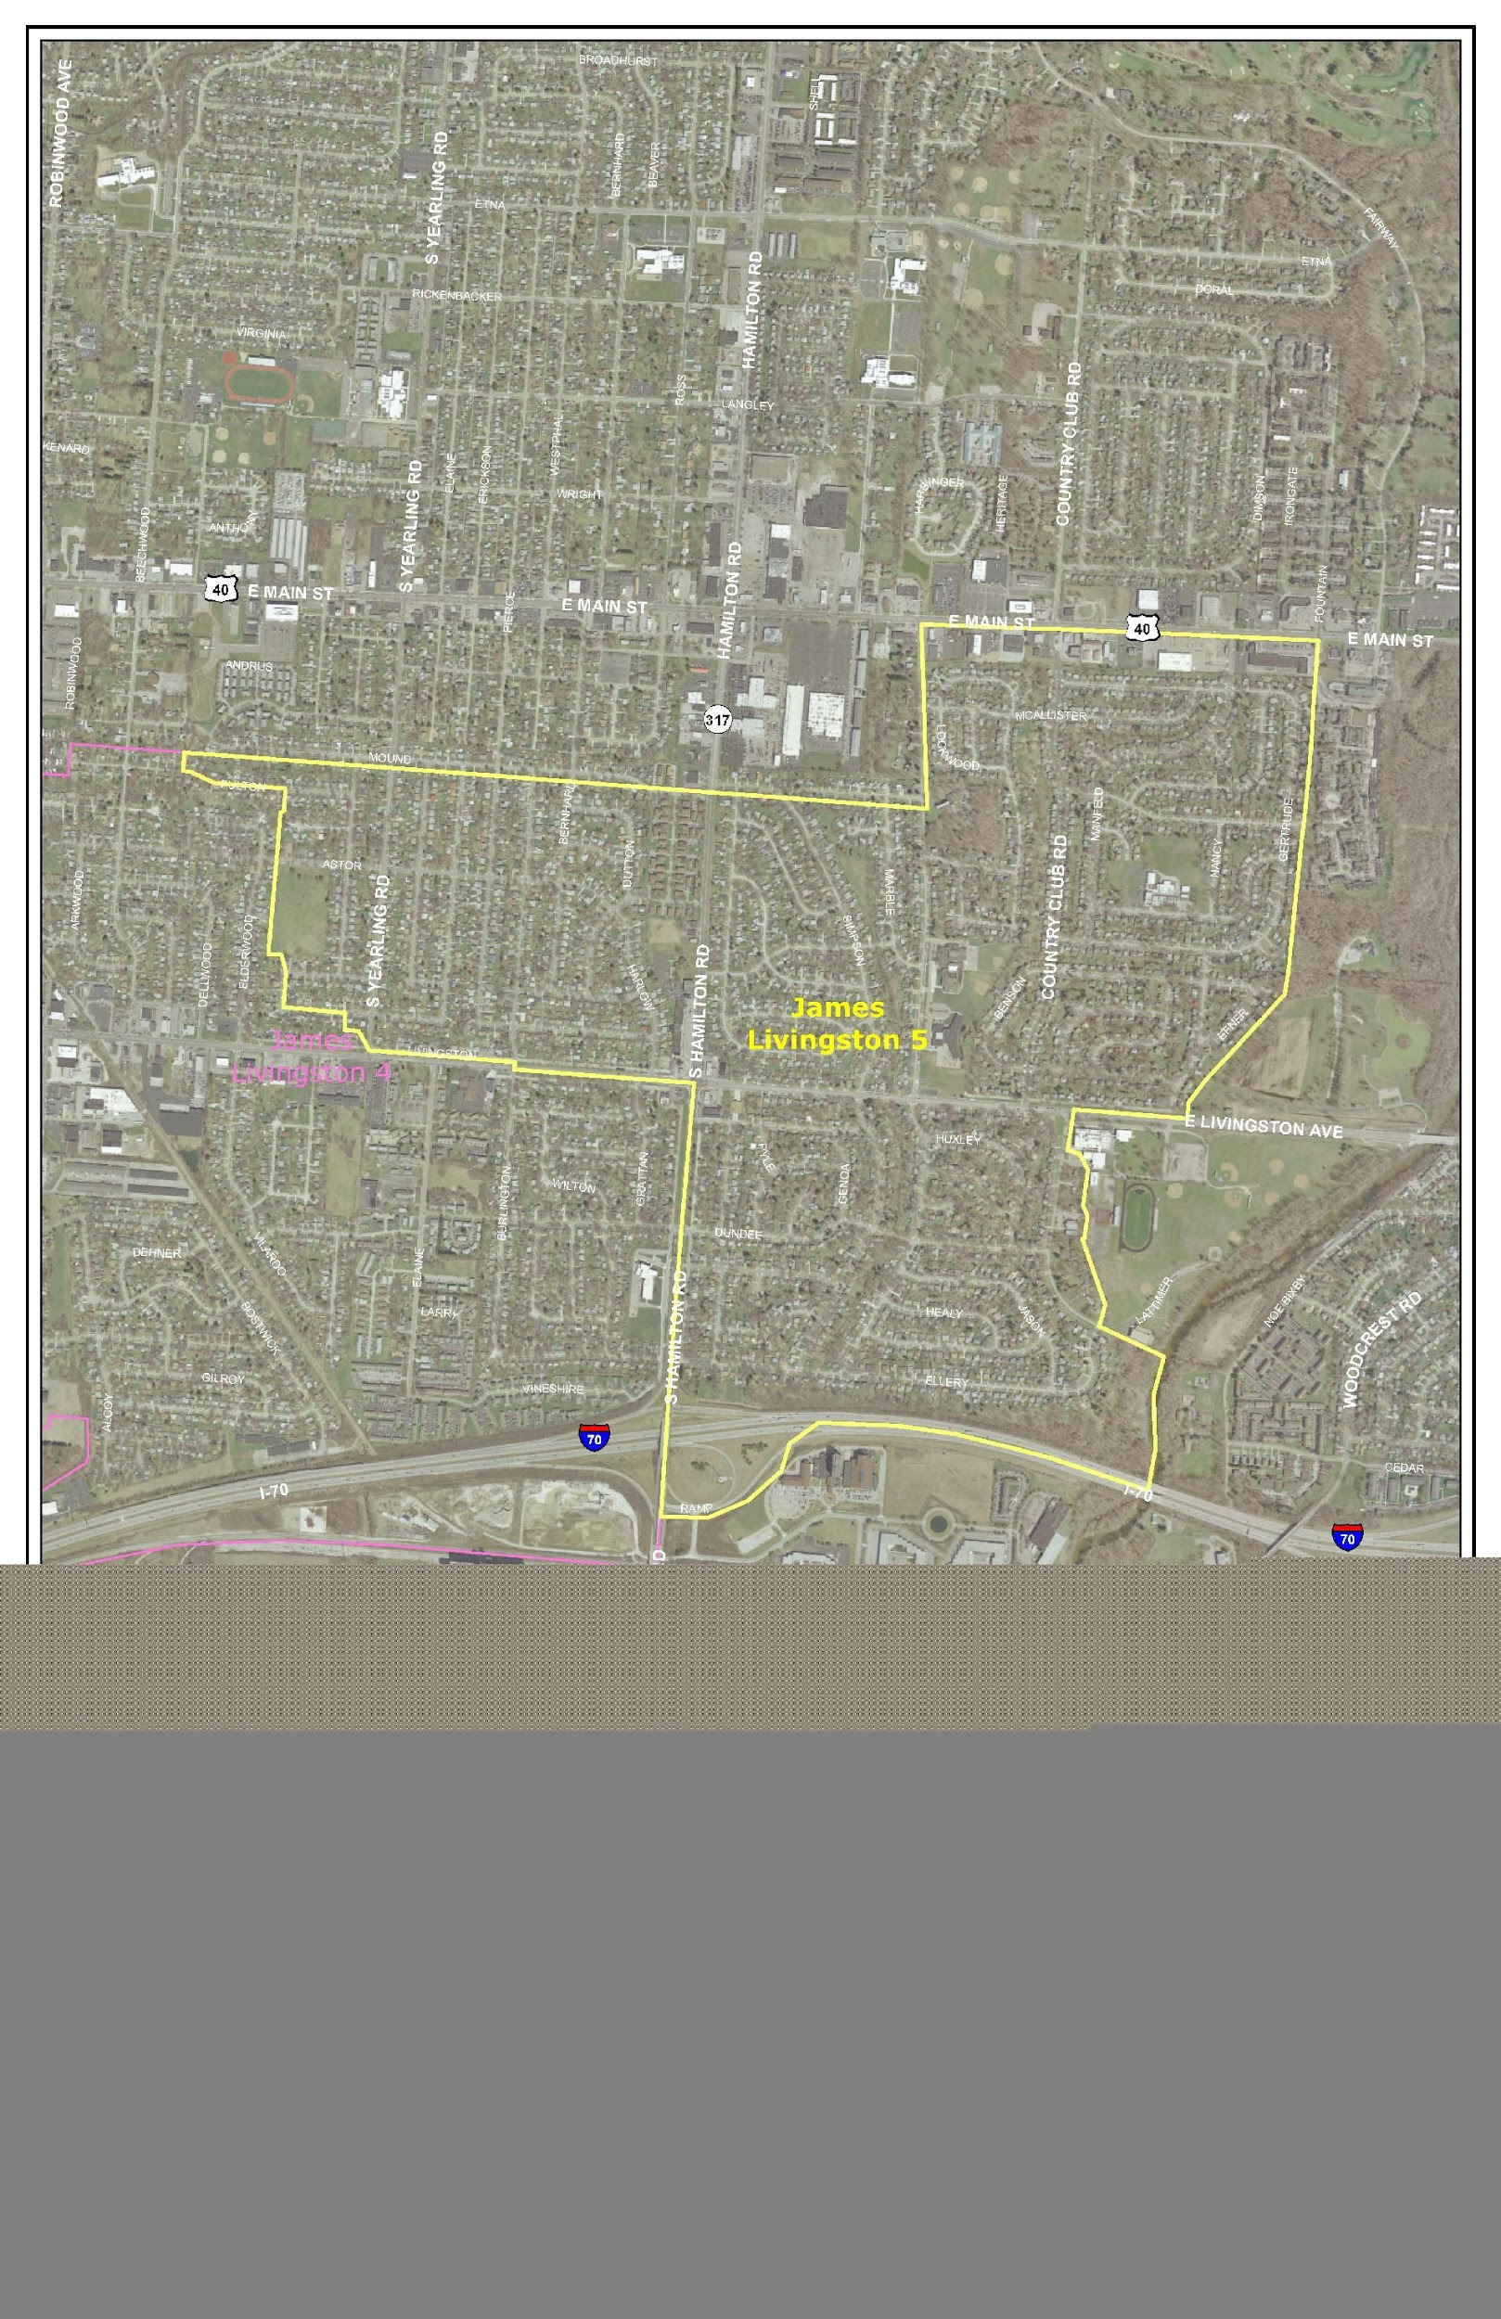
James Livingston 5
Neighborhood
Sullivant Avenue
Map Placeholder
7.5 x 9.75
Whitethorne Avenue
Wiltshire Road
Eakin Road
Notes:
NICK
First, before I go into detail about mainline lining, here’s a map of the project area. It is bordered by Sullivant to the north,….
We are going to start mainline lining here in a few weeks.
Boundaries set by SSOs and what is upstream

Slide 19
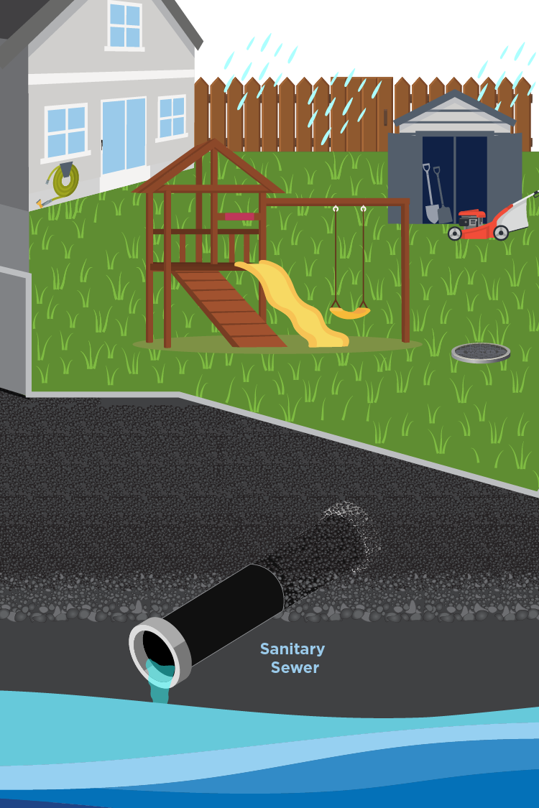
What is a Mainline Sewer?
The mainline sanitary sewer is the large pipe that carries the wastewater from the homes on your street to the treatment plant
Normally, this pipe is in the street
In this area, the pipe runs through a utility easement behind your homes
Notes:
NICK – so let's start with the basics....

Slide 20
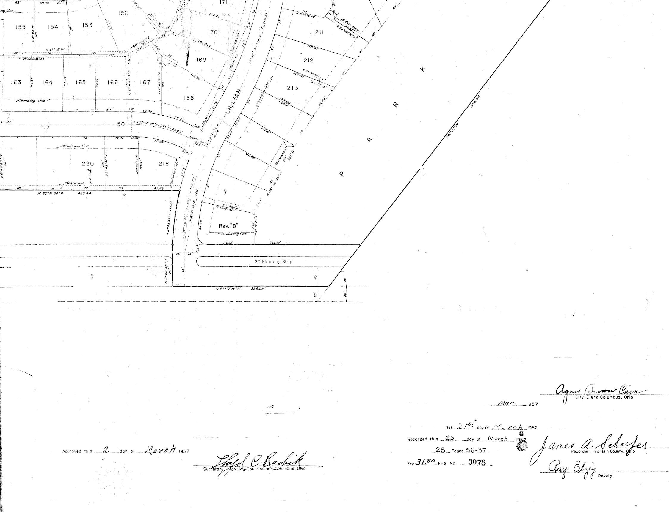
What is a Utility Easement?
A legally-defined portion of a property where a utility company has the right to access it for installation, maintenance, and repair of public utilities
These easements have been in place since the 1950s
Notes:
NICK
Easements were included in the plat from when the neighborhoods were developed

Slide 21
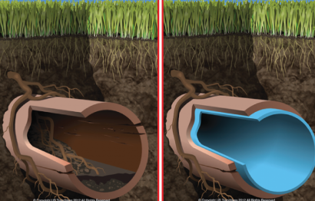
What is Mainline Lining?
A process to maintain the sewer system
Crews clean and line the pipes, seal cracks and defects, and remove grease, roots and other deposits
BEFORE
AFTER
Notes:
NICK

Slide 22
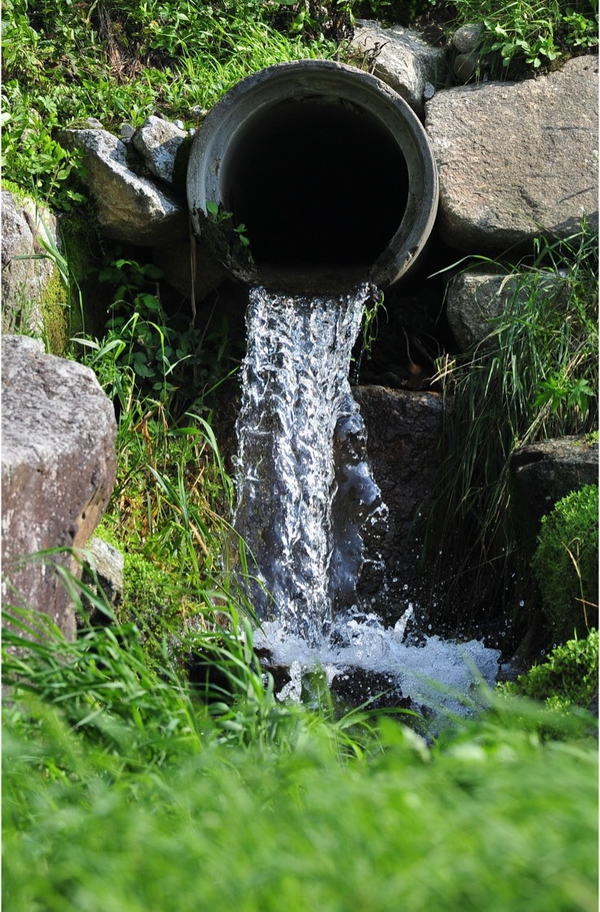
What are the Benefits?
This prevents rain water from entering into the system
Reduces sanitary sewer overflows
Helps to eliminate basement backups
Notes:
NICK
Focus point
Water in basements as well, purpose is to move and clean

Slide 23
The Mainline Lining Process in Your Neighborhood
Notes:
NICK
REMINDER TO HOLD QUESTIONS UNTIL AFTER THE PROCESS

Slide 24
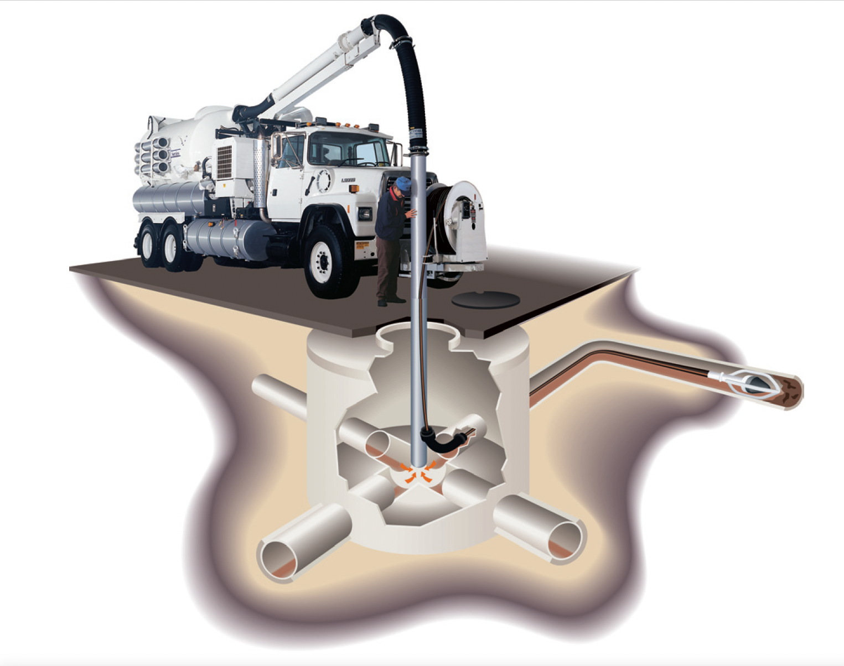
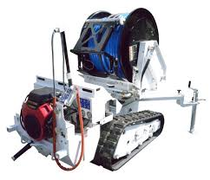
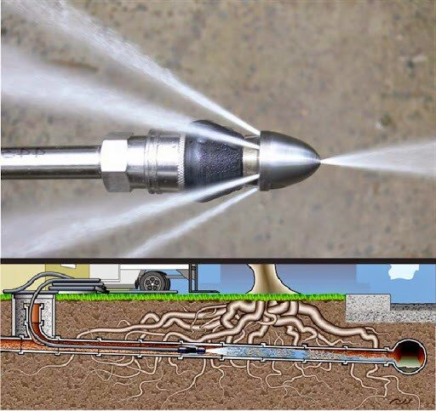
Phase 1-Cleaning & Televising
The crew will survey the area, locating all manholes and identifying those that need to be raised
Starting from a manhole, the crew will insert a jetter into the pipe to clean out roots and debris
Next, a camera will record the condition of the pipe
Any defects or cracks will be identified at this stage. Residents will be notified if there is a point repair needed in the sewer on city easements behind their property.
Notes:
NICK

Slide 25
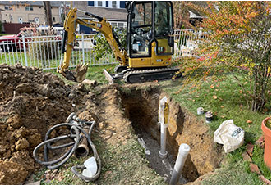
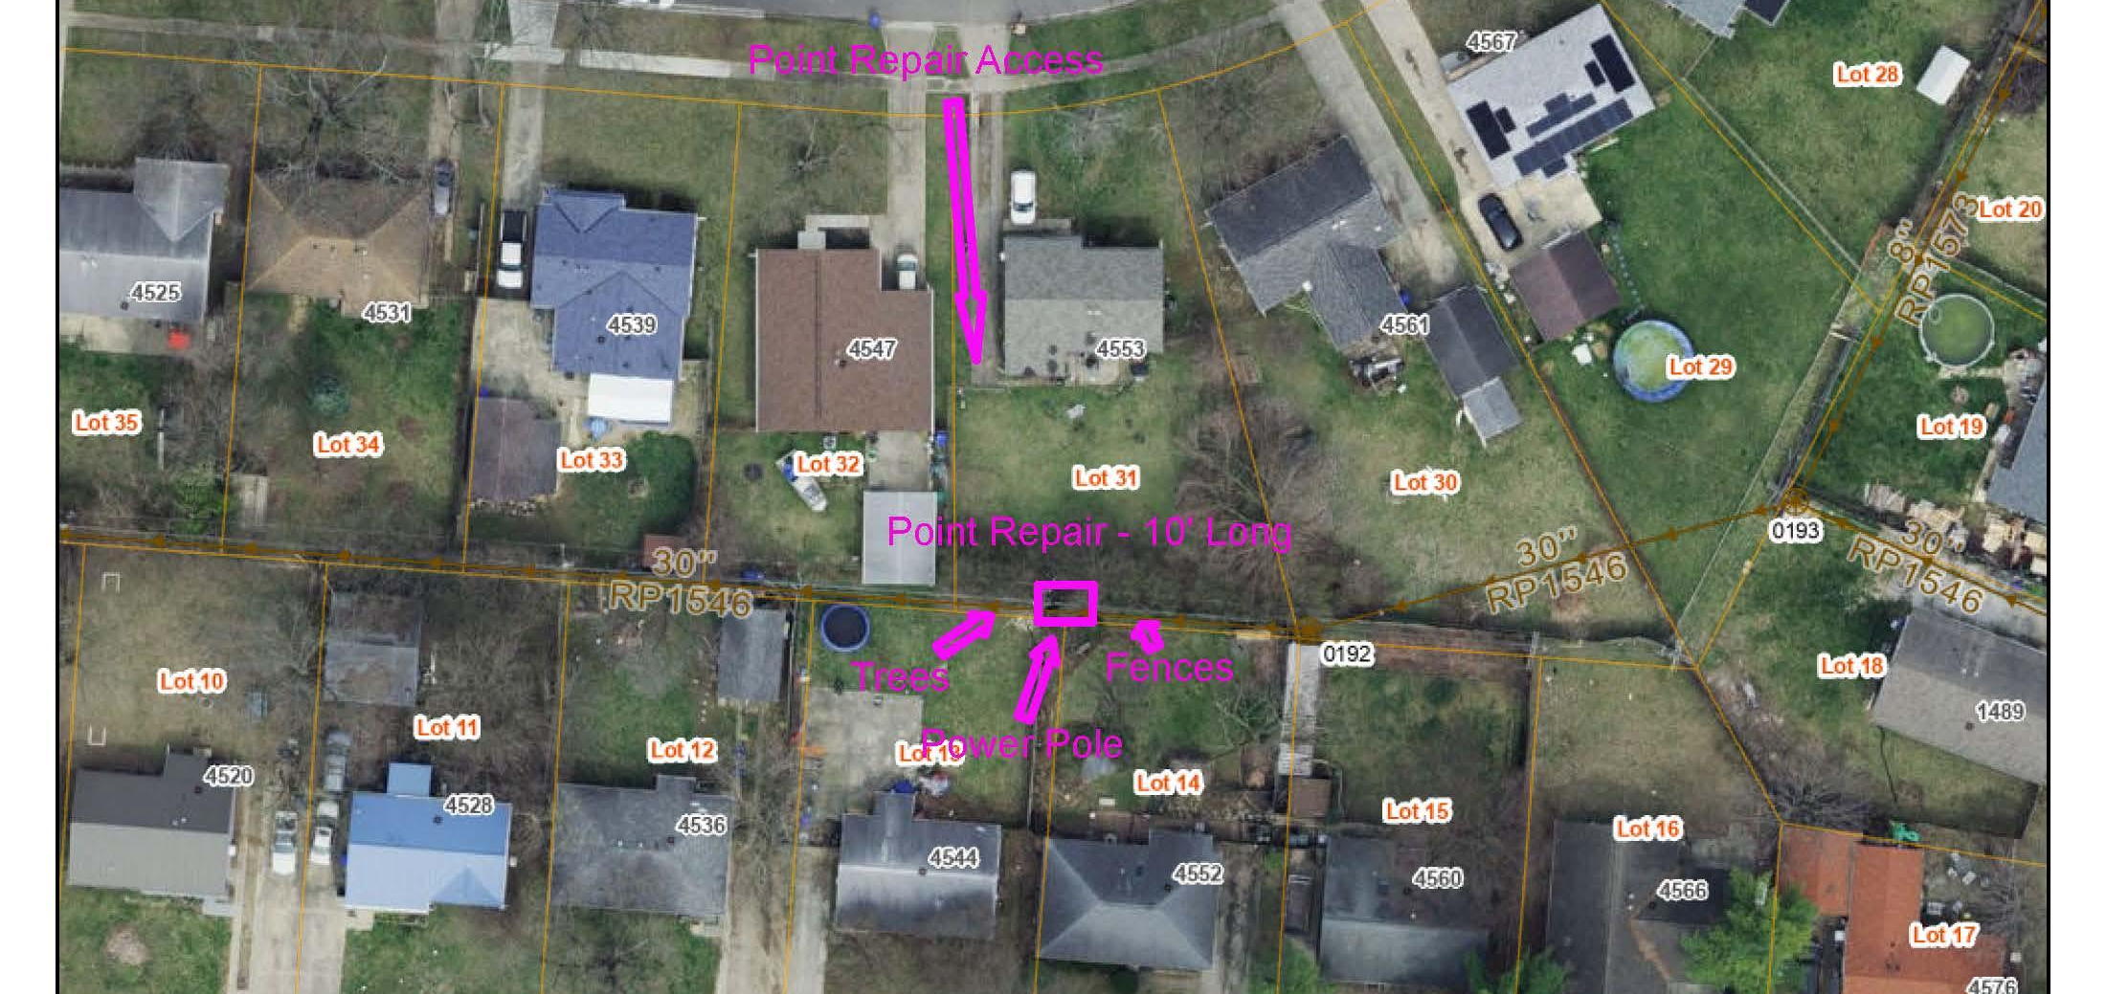
Phase 1-Point Repairs
Crews will excavate the area to expose the pipe to repair it
They may need to remove trees, fences, shed, playground equipment, etc. for this work
Residents will be notified and a meeting will be scheduled to discuss these details
Notes:
NICK – emphasize they may have items in the city easement, which many do not realize

Slide 26
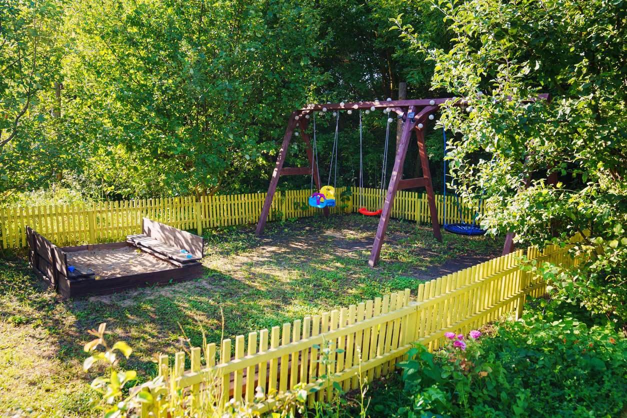
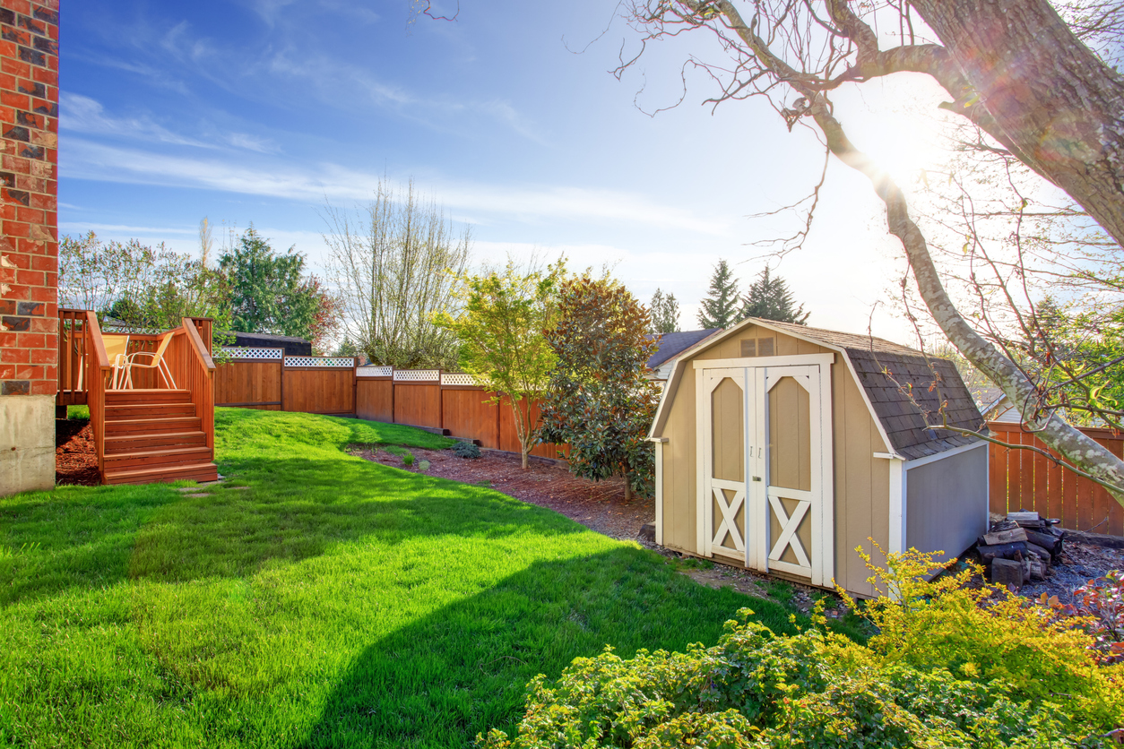
Possibly Within Easement
Fences
Trees
Sheds
Swing sets and playgrounds
Sandboxes
Notes:
NICK
Some trees may be impacted from green infrastructure, sidewalk construction, waterline replacement and storm pipe installations

Slide 27
Phase 2-CIPP Pipe Lining
How Residents can Prepare
Pour water in drains and traps to help prevent odors from lining getting into your house
Don't flush, shower or wash clothes during lining process
It's ok to use your sink for cooking
Cured-in-place pipelining is a trenchless technology
It occurs from manhole to manhole, in segments of about 1000 ft.
Equipment will be in backyards
This process takes between 8 and 24 hours to complete.
Residents will be notified before lining starts
BEFORE
AFTER
Notes:
NICK
(confirm how using your sink is still possible?)

Slide 28
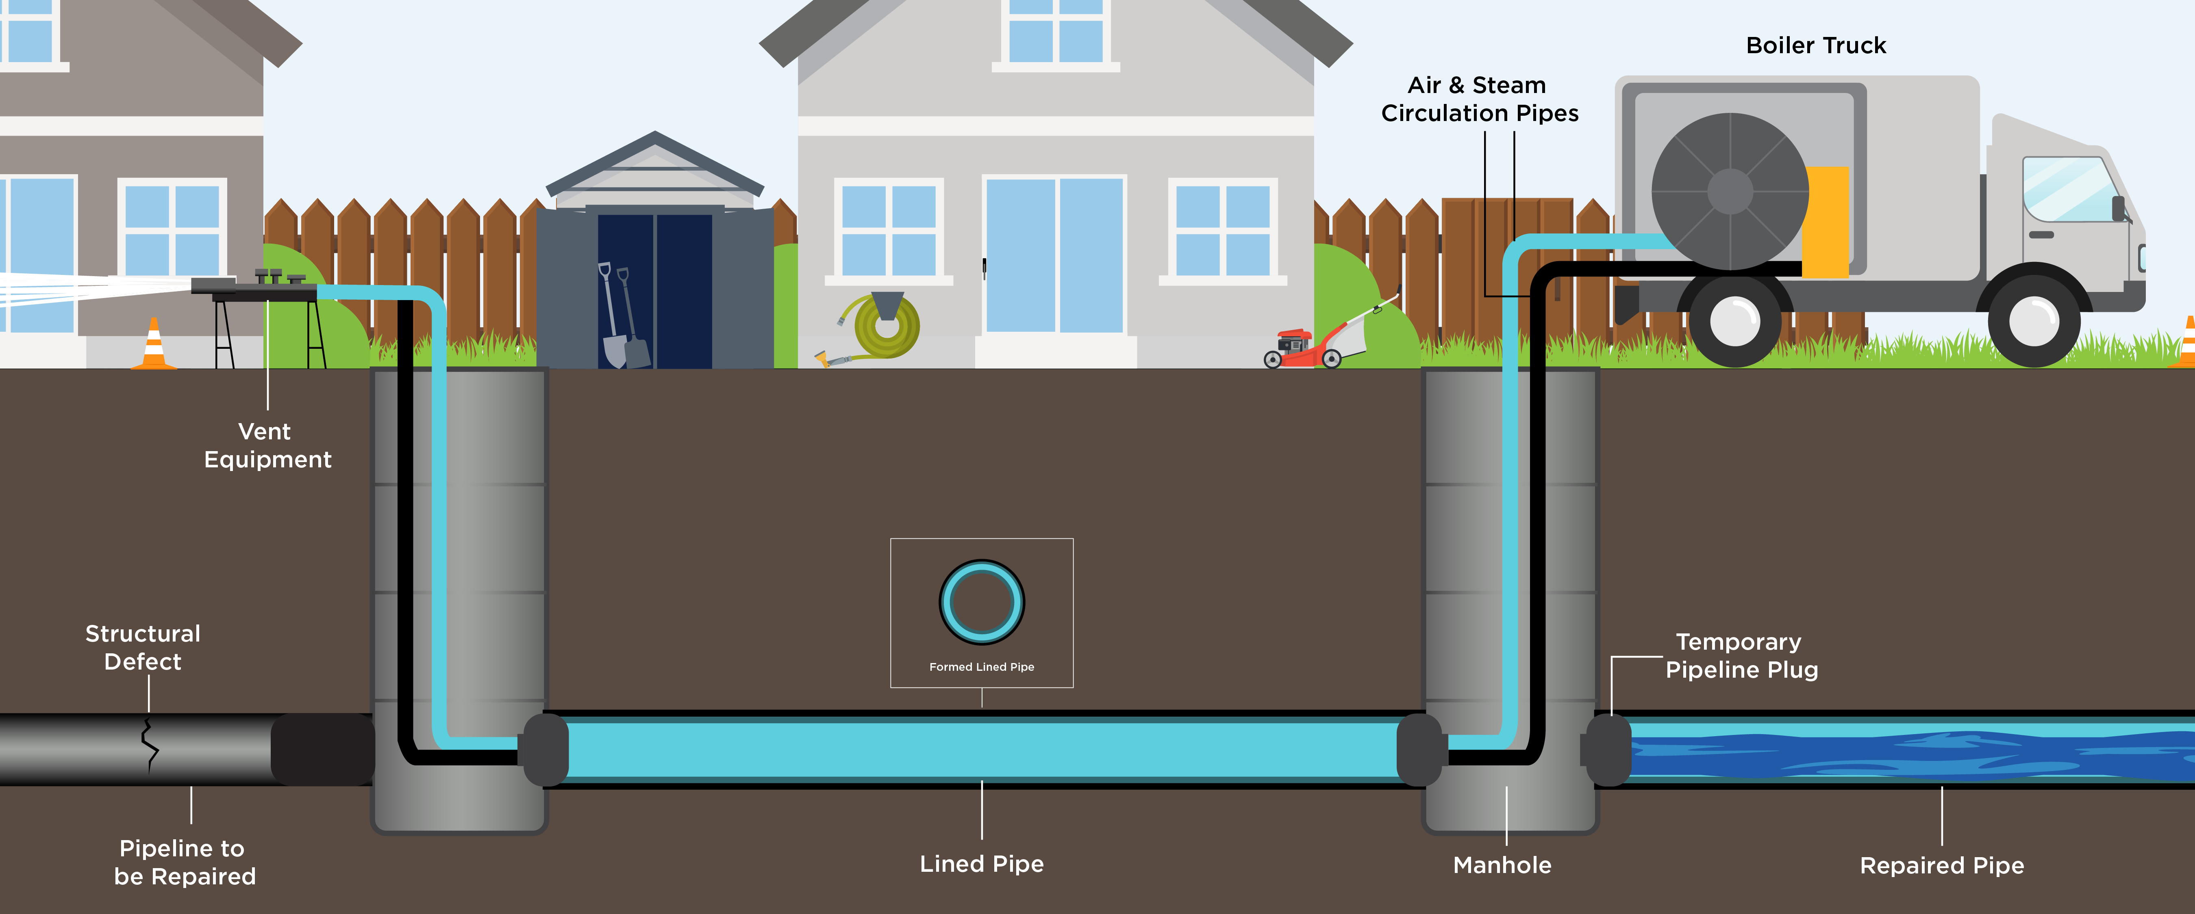
CIPP Pipe Lining: What to Expect
Notes:
NICK

Slide 29
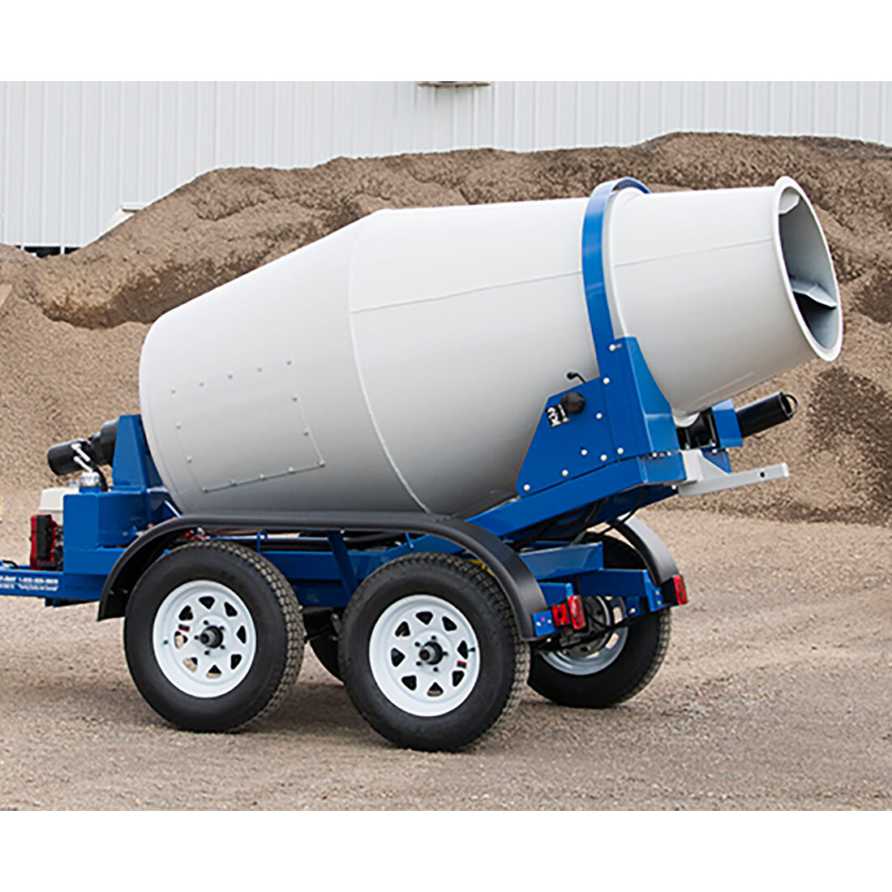

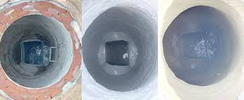
Phase 3-Manhole Rehabilitation
Some manholes will need to be restored and raised to the proper height
These adjustments will require excavation
It may coincide with lining
Disturbances or disruptions will be communicated and kept to a minimum
  Every manhole will need to be accessed
Notes:
NICK

Slide 30
Restoration Work
Phase 1:
Cleaning and televising
Little to no restoration
Care will be taken to preserve trees, grass and grade to the extent possible
Point Repairs
Mounds of dirt on top of filled excavation site will settle; there may be ponding around them at first
Multiple rounds of seeding may be necessary
Affected fences and sheds will be put back
Affected trees will be replanted
Phase 2:
CIPP Sewer Lining
Will vary
Care will be taken to preserve trees, grass and grade to the extent possible
Phase 3:
Manhole Rehabilitation
Minor grading
Seed and straw
Notes:
NICK

Slide 31
Pause for Questions
Notes:
NICK, TIFFANY, CAMERON

Slide 32
What’s Next? Outreach
Notes:
CAMERON

Slide 33
Schedule & Outreach-Design Phase
Current Phase
MANHOLE RECON
PHASE 1
Cleaning & Televising
PHASE 2
CIPP Lining
PHASE 3
Manhole Rehabilitation
RESTORATION
Manholes will be located and those needing rehabilitated will be identified.
Sewer main lines will be cleaned and televised to identify cracks or defects. Point repairs identified.
Sewer main lines will be lined with resin that will be cured in place. Work takes place manhole to manhole in segments.
Manholes will be raised and lined with cementitious mortar.
Areas will be restored with grading, seed and straw.
BLUEPRINT OUTREACH & CONSTRUCTION TEAMS KEEPING YOU INFORMED
Public Meeting
Letter
Door Hanger
Surveyor Onsite
Door Hanger
Site visit with team if point repair is identified
Door Hanger
Crew members and outreach available for concerns
Door Hanger
Seed, straw and grading
Communication regarding replacing trees
Notes:
CAMERON – TIFFANY
We are currently at 60% design. What that means is…..

Slide 34
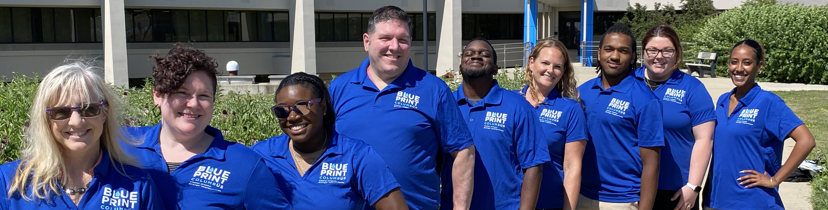
Your Outreach Team
Notes:
CAMERON

Slide 35
OPEN HOUSE
For property-specific or other questions not addressed here, please email or call the
Outreach Team
614-645-1253
blueprint@columbus.gov
Notes:
ALL
We will coordinate with PM’s and engineers to get responses.
This is what we want to know from you...... Shed, fences, breathing trouble, major concerns

Slide 36


Thank you!
blueprintneighborhoods.com
Follow us!
@blueprintcbus
Notes:
ALL

Slide 37
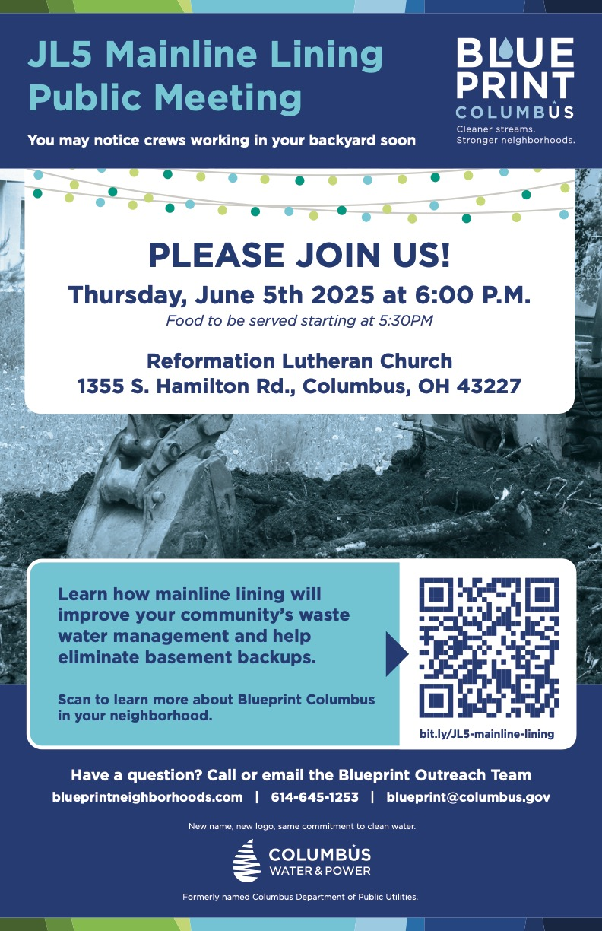
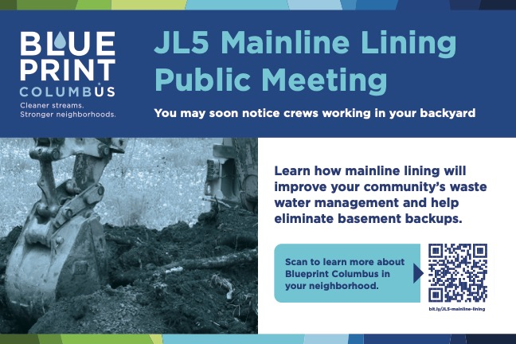

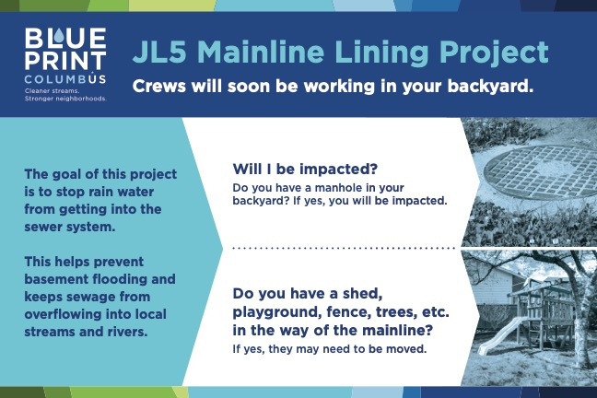
Notification Process
Mailings to property owners
Door hangers posted one week prior to beginning (confirm)
Outreach team activities
DOOR HANGER
POSTCARD MAILERS
POSTER

